Slide 1
Disability Service Safeguards Code of Conduct Webinars - Stakeholder Pack
April 2026

Slide 2
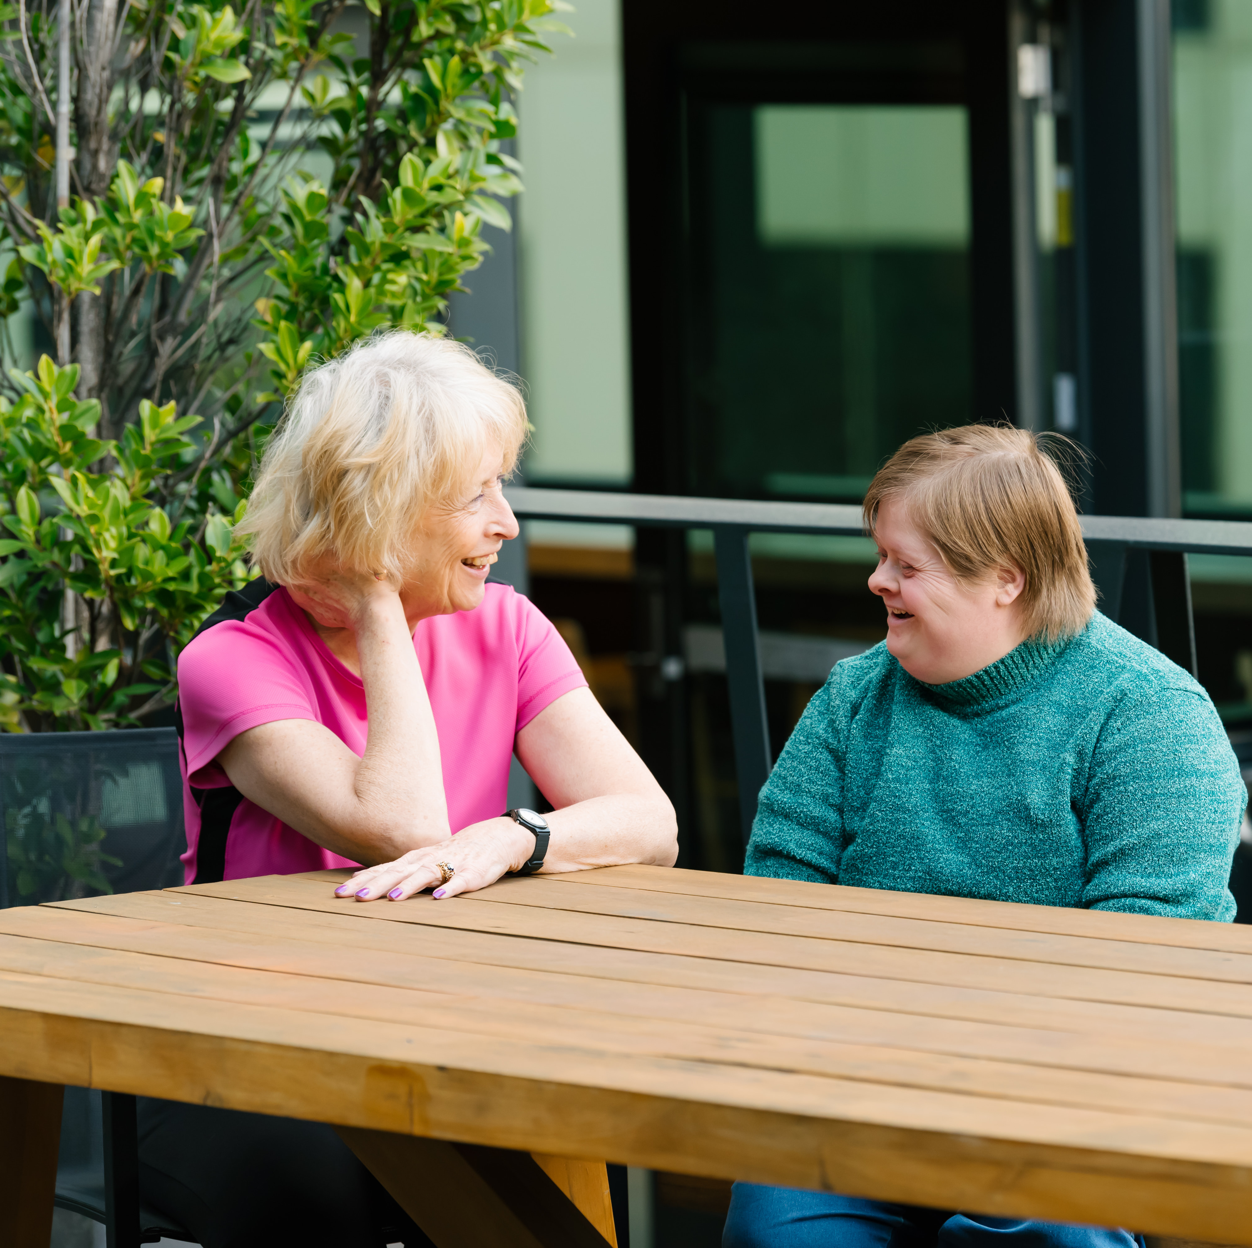
Code of Conduct webinars
Overview
The Victorian Disability Worker Commission is running a series of webinars on the Disability Service Safeguards Code of Conduct for all disability workers in Victoria.
The Code of Conduct is a legal requirement that sets out how disability workers must provide safe, quality services to people with disability – no matter how they are funded.
Our webinars will help educate workers on their legal responsibilities as a disability worker, and support workers to deliver safe and high-quality care to people with disability
Webinars will be held on 28 April, 26 May and 23 June 2026.

Slide 3



Seeking your support
Help us promote the webinars
You can help by:
sharing and publishing the materials in this stakeholder pack via your social media channels, newsletters or any other channels you use to communicate with disability workers
directing disability workers to sign-up for the webinars via our event registration page https://events.humanitix.com/vdwc-code-of-conduct-webinar-series
Tag us
facebook.com/VDWCommission
vicdwcommission​
linkedin.com/company/vdwcommission

Slide 4
What’s in this pack?
What’s in this pack?
e-news story
Social media tiles and suggested copy
Web and email banners
Flyer
Event registration link: https://events.humanitix.com/vdwc-code-of-conduct-webinar-series
Download assets from our drop box, or right click on the images in this pack

Slide 5
e-news story
e-news story for emails, newsletters and websites
Code of Conduct webinars for disability workers
The Victorian Disability Worker Commission is hosting free online webinars on the Disability Service Safeguards Code of Conduct for all disability workers in Victoria.
The Code of Conduct sets out how you must provide safe, quality services to people with disability — no matter how you are funded.
The webinars will help you understand how to apply the Code of Conduct in your day-to-day work and your legal requirements as a disability worker.
Free online webinars will cover specific elements of the Code.
28 April, 10 am – Element 3: Providing supports and services in a safe and competent manner, with care and skill
26 May, 10 am – Element 5: Promptly take steps to raise and act on concerns about matters that may impact the quality and safety of supports and services provided to people with disability
23 June, 10 am – Element 6: Take all reasonable steps to prevent and respond to all forms of violence against, and exploitation, neglect and abuse of, people with disability.
Sign up for the webinars at: https://events.humanitix.com/vdwc-code-of-conduct-webinar-series
Find out more about the Code of Conduct at: https://www.vdwc.vic.gov.au/disability-worker-code-of-conduct

Slide 6

Social media tiles and suggested copy
April Webinar – social tile
Alt tag
Female disability worker supporting a lady with disability playing with her dog in a garden
Suggested copy
Sign up for free Code of Conduct webinars
The Victorian Disability Worker Commission invites all disability workers to attend their Disability Services Safeguards Code of Conduct webinars.
Understand how to apply the Code of Conduct in your everyday work and your legal requirements as a disability worker.
The Code of Conduct sets out how you must provide safe, quality services to people with disability – no matter how you are funded.
Learn about – Element 5: Providing supports and services in a safe and competent manner with care and skill.
Date: 28 April at 10am
Sign-up now https://events.humanitix.com/vdwc-code-of-conduct-webinar-series

Slide 7

Social media tiles and suggested copy
May Webinar – social tile
Alt tag
Male disability worker supporting a lady with disability at a plant nursey
Suggested copy
Sign up for free Code of Conduct webinars
The Victorian Disability Worker Commission invites all disability workers to attend their Disability Services Safeguards Code of Conduct webinars.
Understand how to apply the Code of Conduct in your everyday work and your legal requirements as a disability worker.
The Code of Conduct sets out how you must provide safe, quality services to people with disability – no matter how you are funded.
Learn about – Element 5: Promptly take steps to raise and act on concerns about matters that may impact the quality and safety of supports and services provided to people with disability.
Date: 26 May at 10am
Sign-up now https://events.humanitix.com/vdwc-code-of-conduct-webinar-series

Slide 8

Social media tiles and suggested copy
June Webinar – social tile
Alt tag
Male disability worker supporting a lady with disability sitting at a table with a laptop
Suggested copy
Sign up for free Code of Conduct webinars
The Victorian Disability Worker Commission invites all disability Workers to attend their Disability Services Safeguards Code of Conduct webinars.
Understand how to apply the Code of Conduct in your everyday work and your legal requirements as a disability worker.
The Code of Conduct sets out how you must provide safe, quality services to people with disability – no matter how you are funded.
Attend the final webinar.
Learn about – Element 6: Take all reasonable steps to prevent and respond to all forms of violence against, and exploitation, neglect and abuse of, people with disability.
Date: 23June at 10am
Sign-up now https://events.humanitix.com/vdwc-code-of-conduct-webinar-series

Slide 9


Banners and flyer
Website banner
Newsletter banner
Flyer

Slide 10
Thank you
For more information, please email carolyn.petrovic@vdwc.vic.gov.au

