Slide 1
Understanding the
Disability Worker Regulation Scheme changes
Presented by [insert name of organisation]

Slide 2
Victoria has a new regulator for a stronger, safer disability sector.
A new Victorian Disability Worker Commission was established on 1 July 2020.
It’s responsible for:
new rules for all disability workers in Victoria, regardless of funding source
new complaints service about disability services to protect the safety of people living with disability.
Notes:
Victoria has a new regulator for all disability workers.
These regulations reflect Victorian Government and community expectations to create stronger safeguards and oversight for people with disability, service providers and disability workers.
They are delivered by a newly established, independent entity, the Victorian Disability Worker Commission.
The changes started from 1 July 2020

Slide 3
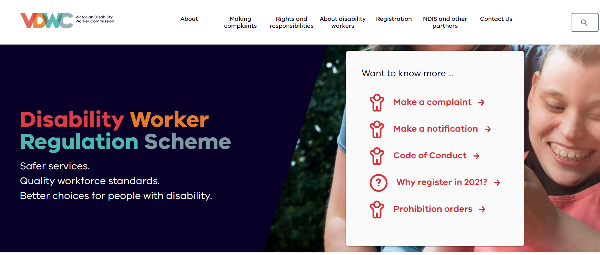
It is a unique regulator, focused on all Victorian disability workers.
The Commission is the first of its kind to be established in Australia.

Slide 4
Its work falls under the Disability Service Safeguards Act.
Changes are legislated under the Disability Service Safeguards Act 2018 (Vic).
The Act is designed to protect people engaging with disability services from harm and support safe services. It also aims for quality improvements across the disability sector.
Notes:
The Disability Service Safeguards Act 2018 (Vic) (the Act) aims to protects vulnerable people from harm and supports improvements across the disability sector.
The Commission will oversee the implementation of new regulations for all Victorian disability workers, and ensure better protections for people using these services.

Slide 5
All parts of the disability services sector are impacted by the changes.
All parts of the disability services sector are affected by the changes.
These changes affect:
all individual disability workers
all disability service providers (organisations)
people engaging with disability services, and their families friends and carers.
Notes:
The new Victorian regulations extend to all disability workers or health workers providing support services to someone living with disability.
That includes disability workers, allied health services, and disability service providers.
In this way, it provides certainty for people using disability services, that they can expect the same standards no matter what funding or service.

Slide 6
There are four main changes to disability services in Victoria.
Mandatory obligations
The Disability Service Safeguards Code of Conduct
A new Code of Conduct that all disability workers in Victoria must follow, regardless of how their services are funded.
Mandatory notifications obligations
Under the law, all disability workers, and disability worker employers, must report any worker they believe has engaged in notifiable conduct to the Victorian Disability Worker Commission.
New regulatory services
An independent complaints service
A new independent and impartial service, with the power to investigate the conduct of disability workers.
A public register of banned disability workers
That lists the names of individuals banned from working in the disability sector due to misconduct.
Notes:
The main changes introduced by the Victorian Disability Worker Commission are:
A disability worker code of conduct – consistent with the NDIS code of conduct, so the standards are the same – which applies to all workers providing services to people with disability, no matter whether they are funded through the NDIS or by other funding sources.
Mandatory notifications if a worker sees misconduct – which means everyone working in disability or for a disability provider must report misconduct to the new commission.
An free, independent complaints and investigation service – so anyone with concerns about the conduct of a disability can report it to the commission, which has the power to investigate and ban workers.
A public register of workers banned for misconduct.

Slide 7
Workers benefit from clear, consistent standards, aligned to the NDIS .
The Disability Service Safeguards Code of Conduct requires that disability workers must:
      1. Act with respect for individual rights to freedom of expression, self-determination and decision-making in accordance with applicable laws and conventions.
      2. Respect the privacy of people with disability.
      3. Provide supports and services in a safe and competent manner, with care and skill.
      4. Act with integrity, honesty and transparency.
      5. Promptly take steps to raise and act on concerns about matters that may impact the quality and safety of supports and services provided to people with disability.
      6. Take all reasonable steps to prevent and respond to all forms of violence against, and exploitation, neglect and abuse of, people with disability.
      7. Take all reasonable steps to prevent and respond to sexual misconduct.
      The Code is available by visiting the vdwc.vic.gov.au or calling on 1800 497 132.

Slide 8
Service providers and employers to report conduct that puts others at risk
Mandatory notifications
If you are a disability worker, or employ disability workers, then you are now required under law to report certain conduct from disability workers that may put the people they support at risk.
All disability workers and disability worker employers must make mandatory notifications to the Victorian Disability Worker Commission if they form a reasonable belief that a disability worker has engaged in notifiable conduct.
This is a requirement of the Disability Service Safeguards Act 2018.

Slide 9
What conduct requires mandatory notification?
Notifiable conduct means when a disability worker has:
a. practised as a disability worker while intoxicated by alcohol or drugs
b. engaged in sexual misconduct while practising as a disability worker
c. placed, or may place, the public at risk of harm because the disability worker has an impairment that detrimentally affects, or is likely detrimentally to affect, the disability worker’s capacity to practise as a disability worker, or
placed, or is placing, the public at risk of harm because the disability worker practised, or is practising, as a disability worker in a manner that constitutes a significant departure from accepted professional standards.
Notifications can be made by visiting the vdwc.vic.gov.au or calling on 1800 497 132.
Notes:
You must notify the Victorian Disability Worker Commission as soon as practicable after you form a reasonable belief
that behaviour that constitutes notifiable conduct has occurred.
The Victorian Disability Worker Commission expects you to not delay making a notification once you have formed a reasonable belief.

Slide 10
The Commission takes complaints about any Victorian disability worker.
      Anyone can report a complaint to the Commission; the service is independent and impartial.
      The Commission is a unique regulator because it directly regulates individual disability workers, not service providers.
      It regulates all disability workers in Victoria, regardless of the funding source or the service.
      Complaints can be made about a disability worker’s:
        standard of work;
        knowledge, skill or judgement;
        capacity to provide services safely.
      The Commission has the power to take action; it can investigate reports of worker misconduct and it can ban workers found to have put safety at risk.
      Complaints can be made via an online form at vdwc.vic.gov.au or calling on 1800 497 132.
Notes:
In handling complaints about individual disability workers, the Commission aims to promote the quality, safety, responsiveness and sustainability of the disability workforce.
People using disability services benefit from clear and consistent expectations for all disability workers, no matter how the service is funded.
Service users can be reassured of an independent process which has clear consequences for workers who put safety at risk.

Slide 11
The Victorian Disability Worker Commissioner can issue prohibition orders
The Commissioner has the power to issue prohibition orders of unregistered disability workers.
A prohibition order stops a person from being able to lawfully practise as a disability worker or requires that they can only work if certain conditions are met.
The Commissioner can make a prohibition order if they are satisfied that it is necessary to avoid a serious risk to the life, health, safety or welfare of a person or the health, safety or welfare of the public, and that the unregistered disability worker:
has breached the Disability Service Safeguards Code of Conduct
has been convicted or found guilty of a prescribed offence
has been issued an exclusion, or had a clearance suspended or revoked by an NDIS worker screening unit
is the subject of an interim bar in relation to a NDIS worker screening check
is the subject of (in relation to disability or health services) a prohibition order or banning order by another regulator.
Until registration commences in 2021 these powers apply to all Victorian disability workers.

Slide 12
Voluntary registration for disability workers will start in 2021.
Our best disability workers are dedicated to the people they support. Strong and clear standards help elevate their profession
Disability workers will be able to register under the new regulations and become part of a publicly available list of registered workers.
Voluntary registration for disability workers has been deferred by 12 months, to start from 1 July 2021.
Notes:
Voluntary registration enables disability workers to demonstrate their commitment to excellence.
It is voluntary. Workers who register are signing-up to meeting higher standards.
Registration means all police and employment safety checks are kept up-to-date, making registered workers readily employable without delay across the sector.
Registration is a key part of building a stronger, safer disability sector; but we understand that 2020 has been a difficult year for many in the sector due to disruptions caused by the COVID-19 pandemic.
As a result, we’ve deferred the introduction of voluntary registration until 1 July 2021.

Slide 13
The new regulations help build a stronger, safety disability sector.
Everyone is better protected when standards and rights are clear and upheld.
The regulations support rights established by the Code of Conduct that mean workers, and the people who use their services, know what’s expected, and what to do if expectations are not met.
Our best disability workers are dedicated to the people they support. Clear standards deliver service quality that helps to elevate their profession.
The changes make it easier to identify, report and ban disability workers who do not deliver safe services to the expected standard.
The new regulations introduce changes that support people with disability to feel respected and safe. It makes it easier for people to find high quality support that meets their needs, which enables them to live full and active lives.
Notes:
The changes are important to build a sector that is safer, stronger, and respected for its important work.
Together, clearer standards and additional safeguards better protect the safety of people engaging with disability services.

Slide 14
vdwc.vic.gov.au
@vdwcommission

